Slide 1
BIOM 7110/8110 BIOSTATISTICS
Erno Lindner, Ph.D. (elindner@memphis.edu)
Amber Jennings, Ph.D. (jjnnings@memphis.edu)
M,W: 8:40-10:05 ES 311
eCourseware

Slide 2
Office hours: By appointment
Description:
This course covers the basic statistical techniques used in biomedical engineering (and related disciplines). The lecture material will be supplemented with examples from BME research
Textbook: Primer of Biostatistics, Stanton A Glantz, 7th Edition, McGraw-Hill ISBN-13:978-0-07-176800-9 (This is a book and a CD ROM)
Requirements:
Attendance on lectures and practice classes (on time)
In-class quizzes and home work assignments
Short term paper describing the statistical analysis of a set of data (preferably one collected by the student as a part of his graduate research)
In class presentation of the term paper with lecture notes for the classmates
Final exam
Grading: Two quizzes (40%)
Final (20%)
Term paper / Presentation (20 %)
Home work - in class short quizzes (20 %)

Slide 3
Comments:
Bring your calculator (laptop) to every class
Bring your book and the statistical tables to every class and be prepared for short quizzes
The lecture materials presented as power point slides, home works, additional information related to the class, e.g., practice files, will be uploaded to eCourseware:
eCourseware: lecture notes / examples / home works / pdf files

Slide 4
Biostatics Spring 2016
BIOM 7110/8110
Lindner, Jennings
MW 8:40-10:05, ES 311

Slide 5
Successful statistics typically requires more common sense than mathematical expertise (“common sense is not so common” Voltaire)

Slide 6
Harvey Motulsky: Intuitive biostatistics.
Intuitive:
Intuitive:
Statistics and probability are NOT intuitive
We tend to jump to conclusions: from sample to population
We tend to be overconfident
We see patterns in random data (hot hands in basketball)
We don't realize that coincidence is common
We have incorrect intuitive feelings about probability
We find it hard to combine probabilities
We don't do Bayesian calculations intuitively
We are fooled by multiple comparisons
We tend to ignore alternative explanations
We are fooled by the regression to the mean
We crave certainty but statistics offer probabilities
easy to understand
“instinctive or acting on what one feels to be true even without a reason”

Slide 7
We tend to be overconfident
How good are people at judging how confident they are?
Provide a range you think 90% chance containing the correct answer
 | min | max | true | OK
Martin Luther King's age at death
Length of the Nile river (miles) or km
Number of countries in OPEC (Org.Petr.Exp. Countr.)
Number of books in the Old Testament
Diameter of the Moon (miles) or km
Weight of a Boing 747 (pounds) or kg
Year Mozart was born
Gestation period of an Asian elephant (in days)
Distance from London to Tokyo (miles) or km
Deepest known point in the ocean (miles) or km

Slide 8
http://www.gapminder.org/
http://www.gapminder.org/ignorance/
http://www.ted.com/talks/hans_rosling_shows_the_best_stats_you_ve_ever_seen
http://www.gapminder.org/videos/200-years-that-changed-the-world-bbc/

Slide 9
We have incorrect intuitive feelings about probability
Your job is to pick one ball from one of the
bowls with closed eyes.
You get a large prize by picking a red.
A
B
10=9+1
100=93+7

Slide 10
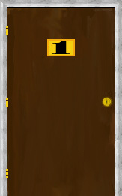
We find it hard to combine probabilities
The Monty Hall problem – Let’s Make a Deal
1
2
3
‎http://math.ucsd.edu/~crypto/Monty/monty.html

Slide 11
What should be your strategy:
SELECTION
Behind door 1 | Behind door 2 | Behind door 3 | Result if staying at door #1 | Result if switching to the door offered
Car | Goat | Goat | Wins Car | Wins Goat
Goat | Car | Goat | Wins Goat | Wins Car
Goat | Goat | Car | Wins Goat | Wins Car

Slide 12
We don't do Bayesian calculations intuitively
We are screening blood donors for the presence of HIV virus
Only 0.1 % of the donors have HIV.
Immunoassay is very good but not perfect
It correctly identifies HIV infected samples 99 % of the times
But 1% of the times it indicates HIV for NOT INFECTED
When this test identifies a blood sample as having HIV present what is the chance that the donor indeed has HIV and what is the chance that the test had a false positive result?
Assume 100,000 tested – (0.1%) 100 has HIV (99 identified 1 NOT)
99,900 without HIV – (1% false positive) 999 will be indicated as infected! = 999+99=1098 will test positive! But only 99 have HIV.
A positive test indicate only 99/1098 = 9% chance of HIV infection. 91% false positive.
In medicine:
Sensitivity-probability of positive tests with “disease”
Specificity-probability of negative tests without disease

Slide 13
Same test but on different population
We are screening blood of intravenous drug users for the presence of HIV virus. Only 10 % of the intravenous drug users have HIV.
Immunoassay is very good but not perfect
It correctly identifies HIV infected samples 99 % of the times
But 1% of the times it indicates HIV for NOT INFECTED
When this test identifies a blood sample as having HIV present what is the chance that the donor indeed has HIV and what is the chance that the test had a false positive result.
Assume
100,000 tested – (10%) 10,000 has HIV (9900 identified 100 NOT)
90,000 without HIV – (1% false positive) 900 will be indicated as infected = 9900+900=10800 will test positive
of which 9900/10,800 = 92 % will be true positive and have HIV and 8 % will be false positive.

Slide 14
Summary of Bayesian calculations Positive HIV test (Same test on two very different groups – populations)
Blood donor
(0.1% is infected)
Intravenous drug user
(10% is infected)
91 % False positive
9 % true positive
8 % false positive
92 % true positive

Slide 15
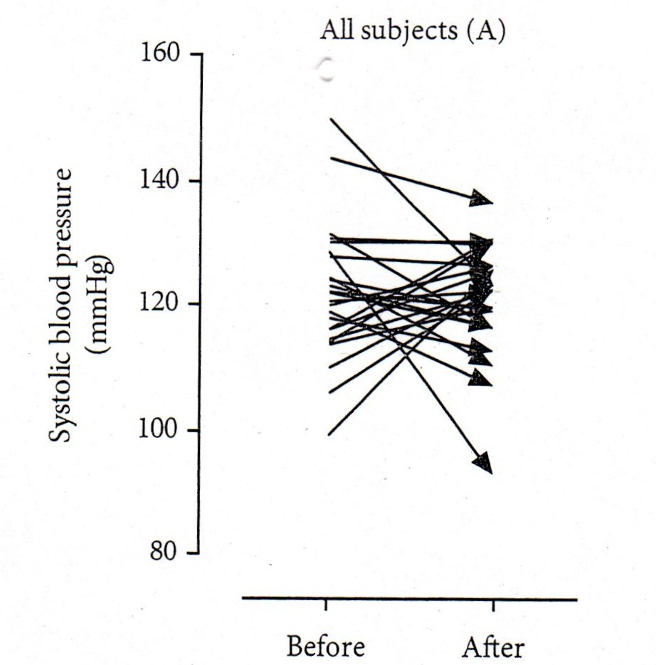
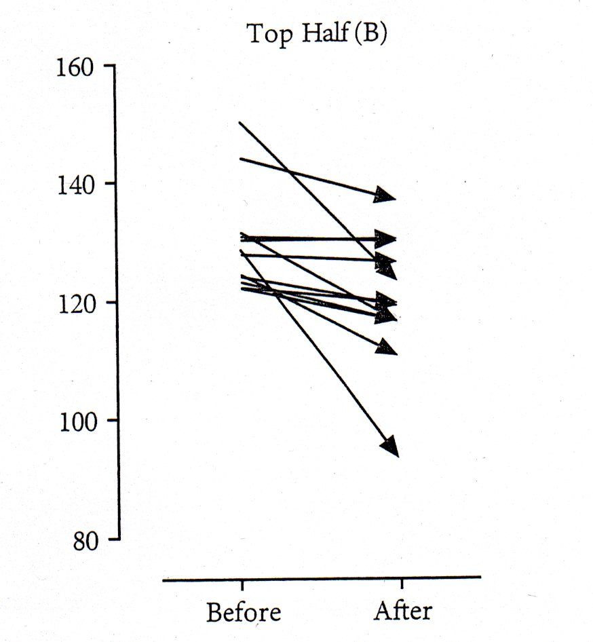
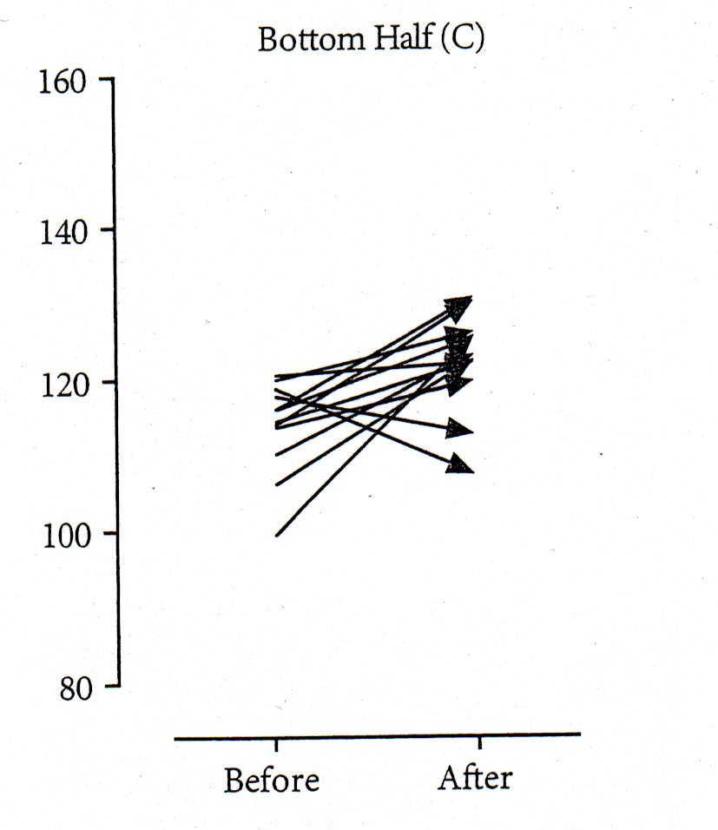
We are fooled by the regression to the mean
Simulated blood pressure data before and after treatment
All data
High BP data
Low BP data

Slide 16





Outlining common errors, both intentional and unintentional, associated with the interpretation of statistics, and how these errors can lead to inaccurate conclusions.
"Lies, damned lies, and statistics"
Disraeli

Slide 17
Most important:
How are the data collected, arranged, presented, plotted
Plotting your data is strongly recommended!
Gives an immediate impression that helps subsequent analysis

Slide 18
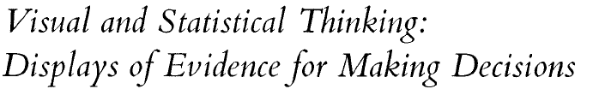

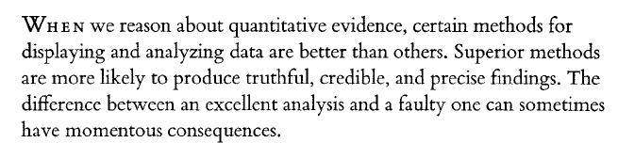
Edward R. Tufte
Visual explanations
Images and Quantities, Evidence and Narrative
Example:
How to stop cholera epidemic (London 1854)
Evaluate whether to launch space shuttle (1986 Jan. 18).

Slide 19
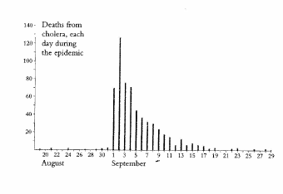
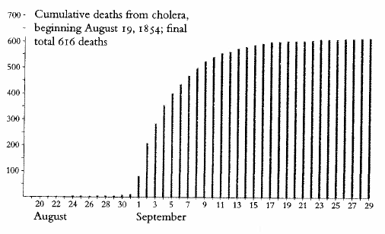
Cholera epidemic in London (1854)
500 fatalities in 10 days
Death from cholera, each day
Aug. 19 - Sept 29
Cumulative death from cholera from Aug. 19 (Total: 616)
John Snow an epidemiologist

Slide 20
500 fatalities in 10 days
John Snow an epidemiologist studied previous outbreaks suspected that water from the community pump is the source.
Who is dying?
Where are they living?

Slide 21
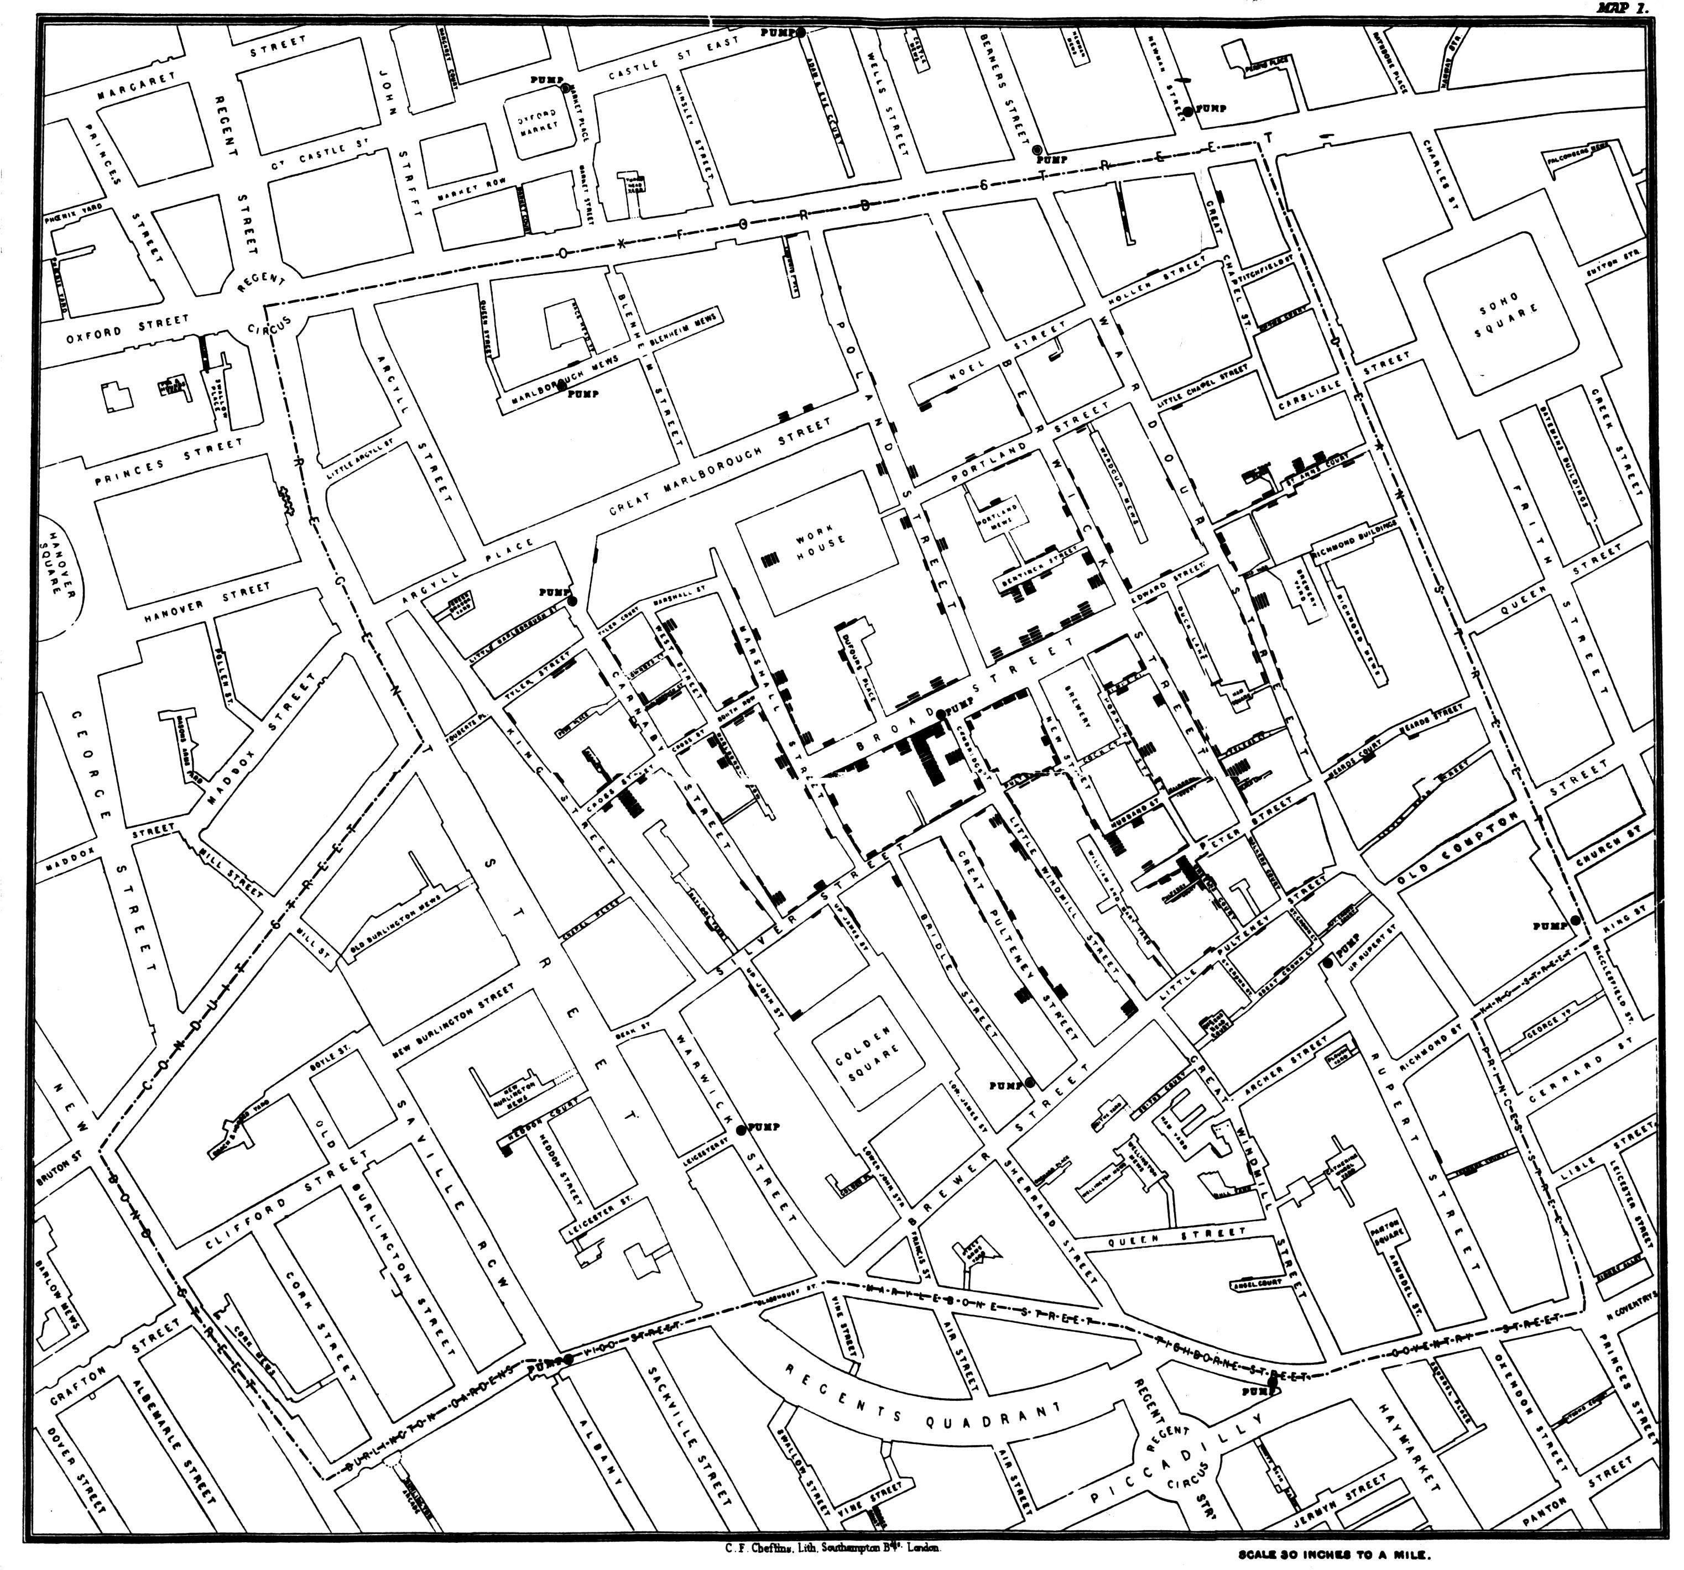

From the registry received the addresses of the dead
plotted a map
with the location and number of fatalities and public pumps
recognized the vicinity of the Broad street pump

Slide 22
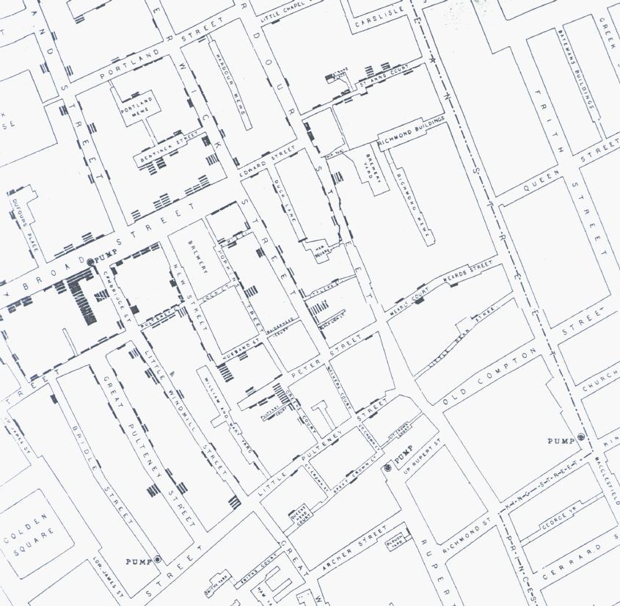
only 10 from 83 were located at areas with another public pump closer than the Broad street pump
Sept. 3: observed samples from the broad street pump - has not seen conclusive evidence
This absence of evidence was not evidence of absence. Have seen different amounts of organic in the water.

Slide 23
10 outliers from 83:
5 sent always for water to the Broad street pump
3 were children who went to school close to the pump
From the remaining 73:
61 used regularly the Broad street pump water
6 could not be confirmed - everybody died
6 did not drink from the water
More outliers (scattered in the city):
cabinet maker worked at Broad street
two ladies who sent for the water

Slide 24
Brewery:
70 worker - none of died from cholera
own well
drank only malt liquor
Work house:
535 inmates - only 5 died from cholera
own pump well and junction to water works
if they were getting water from the Broad street pump 100 should have died

Slide 25
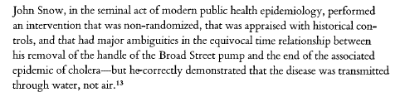
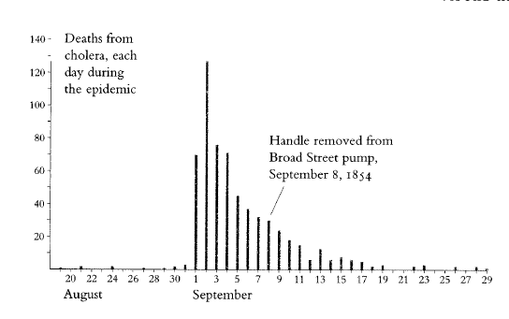
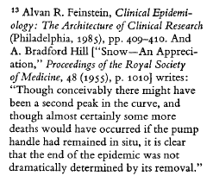
Sept 7, The Board of Guardians ordered to remove the handle
The epidemic soon ended
Changed the assumption on how cholera is spreading (previously it was assumed that through air)

Slide 26
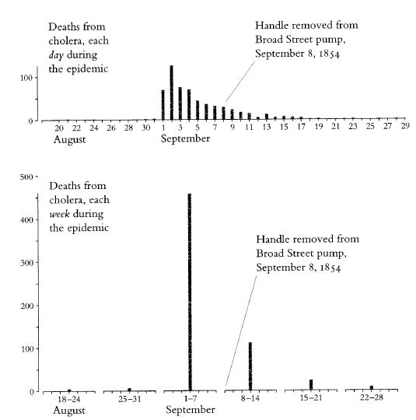
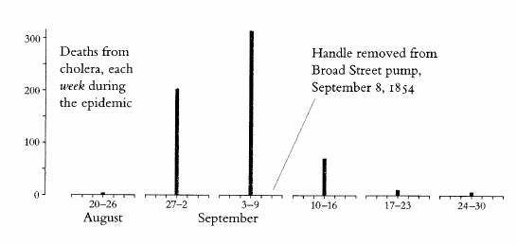

Slide 27
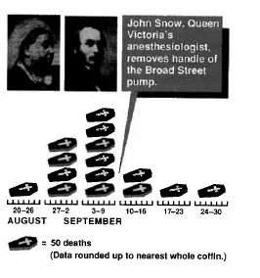

Slide 28
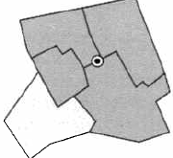
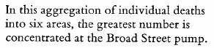
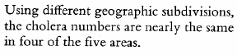
Assessment of errors in the graphics
The dot map fail to take into account living in the area
Dot map does not show the population based rates
Aggregation by area can mask or even distort the true story of the data

Slide 29
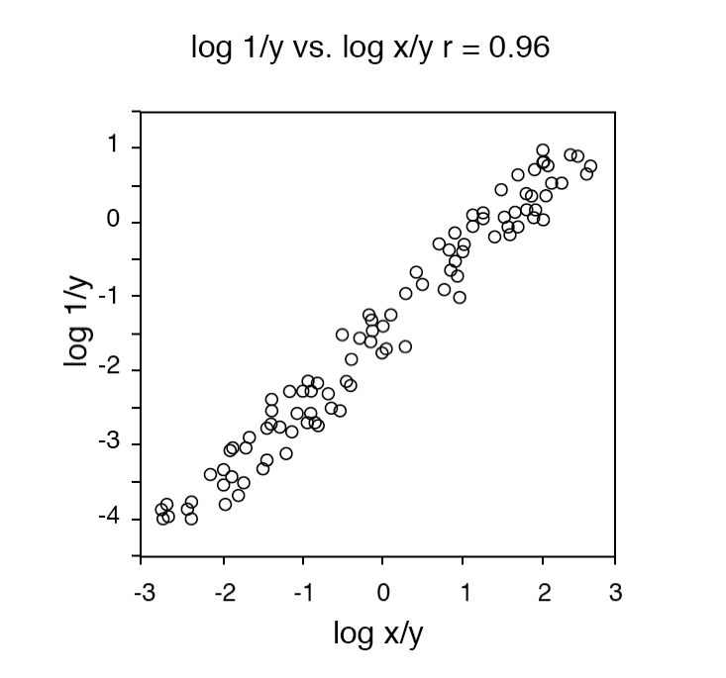
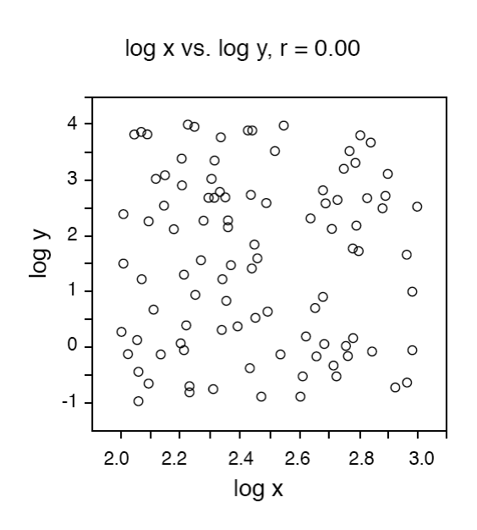
Transformations

Slide 30
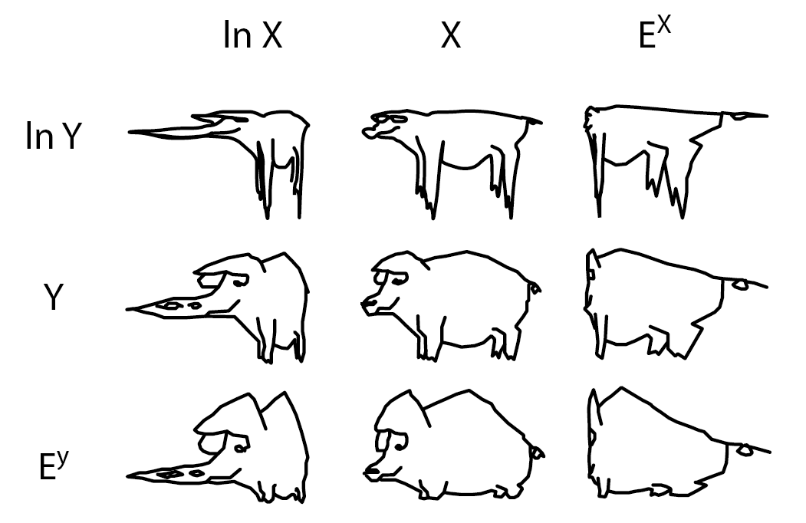
Transformations

Slide 31
Most important:
How are the data collected, arranged, presented, plotted
Plotting your data is strongly recommended!
Gives an immediate impression that helps subsequent analysis

Slide 32
Weights of college students (n=40)
Number | Weight(lbs)
1 | 99
2 | 108
3 | 112
4 | 116
5 | 118
6 | 120
7 | 120
8 | 120
9 | 121
10 | 125
11 | 125
12 | 125
13 | 130
14 | 130
15 | 130
16 | 131
17 | 135
18 | 138
19 | 140
20 | 145
21 | 145
22 | 150
23 | 155
24 | 157
25 | 160
26 | 160
27 | 170
28 | 170
29 | 170
30 | 170
31 | 170
32 | 175
33 | 180
34 | 190
35 | 190
36 | 190
37 | 195
38 | 195
39 | 215
40 | 267
Automatic
Weight | Frequency
90 | 0
100 | 1
110 | 1
120 | 6
130 | 7
140 | 4
150 | 3
160 | 4
170 | 5
180 | 2
190 | 3
200 | 2
210 | 0
220 | 1
230 | 0
240 | 0
250 | 0
260 | 0
 | 1
No axes labels
No figure legend
Small figure - large title
Large unused space for legend
Manual
Fig. 1: Frequency distribution of college students weights (lbs)

Slide 33
The world 2004
A Norwegian diplomat, Charung Gollar, was asked to present the UN with a graphic presentation showing the main problems in the world in 2004. He presented a set of 8 pictures entitled "The power of stars" and was applauded for the simplicity of his idea. In spite of having no pretension at all, his work was presented to participate to the Nobel Prize of Political Marketing. Attached are the 8 pictures presented.

Slide 34

Europe

Slide 35

Angola

Slide 36
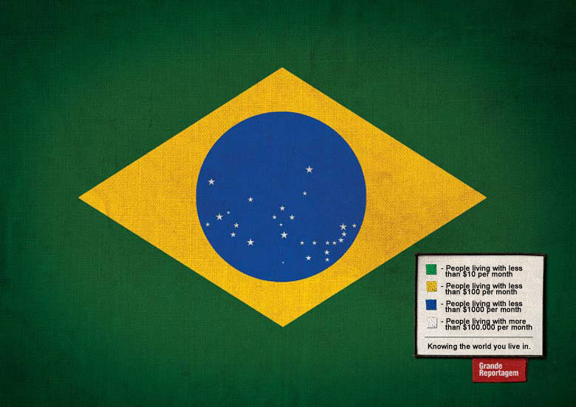
Brazil

Slide 37

Burkina Faso

Slide 38

China

Slide 39

Colombia

Slide 40

Somalia

Slide 41

USA

Slide 42
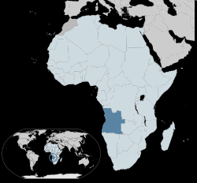
Angola

Slide 43
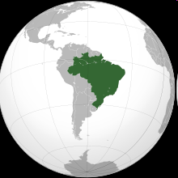
Brazil

Slide 44
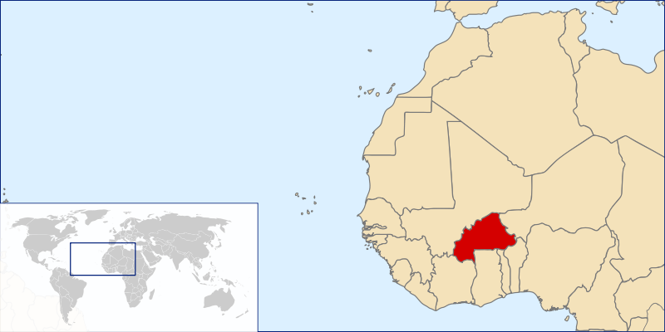
Burkina Faso

Slide 45
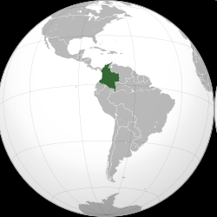
Columbia

Slide 46

Somalia

Slide 47
Most important:
How are the data collected, arranged, presented, plotted

Slide 48
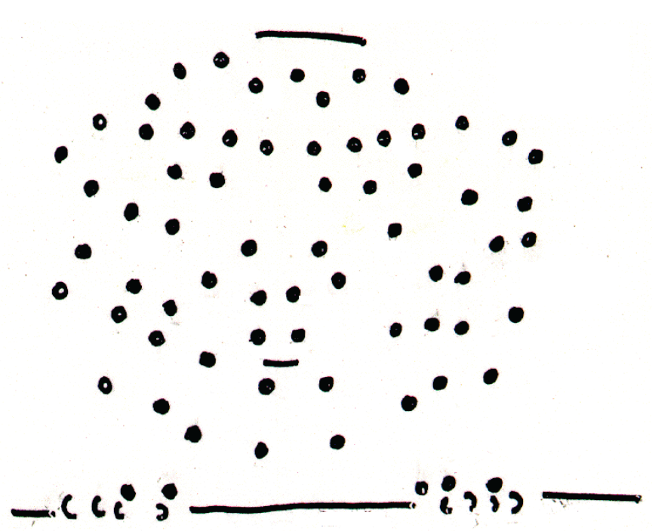
Observations are subjective

Slide 49
Observations are subjective

Slide 50
Observations are subjective

Slide 51
Observations are subjective

